Slide 1
Data Center Infrastructure CT109-3-2&Version 2
Building Automation and Energy Management Systems

Slide 2
Topic & Structure of The Lesson
Building Automation and Energy Management Systems

Slide 3
Learning Outcomes
At the end of this topic, YOU should be able to:
Define BMS & EMS.
Understand what is involved in building automation protocols.
Understand integrated systems and interfaces.

Slide 4
Key Terms You Must Be Able To Use
If you have mastered this topic, you should be able to use the following terms correctly in your assignments and exams:
SOAP
XML
LonWorks
BACnet

Slide 5
BMS
BMS stands for?
A building management system (BMS), otherwise known as a building automation system (BAS)
BMS?
It is a computer-based control system installed in buildings that controls and monitors the building's mechanical and electrical equipment such as ventilation, lighting, power systems, fire systems, and security systems.

Slide 6
BMS
BMS Consists of ?
A BMS consists of software and hardware; the software program, usually configured in a hierarchical manner, can be proprietary, using such protocols as C-Bus, Profibus, and so on.

Slide 7
BMS
BMS produced by?
Vendors
Protocols used by BMS?
BMS integrates the use of Internet protocols and open standards such as DeviceNet, SOAP, XML, BACnet, LonWorks and Modbus.
Example BMS videos?
https://www.youtube.com/watch?v=xI6kst8XKu0
https://www.youtube.com/watch?v=Xgalj4wklPE

Slide 8
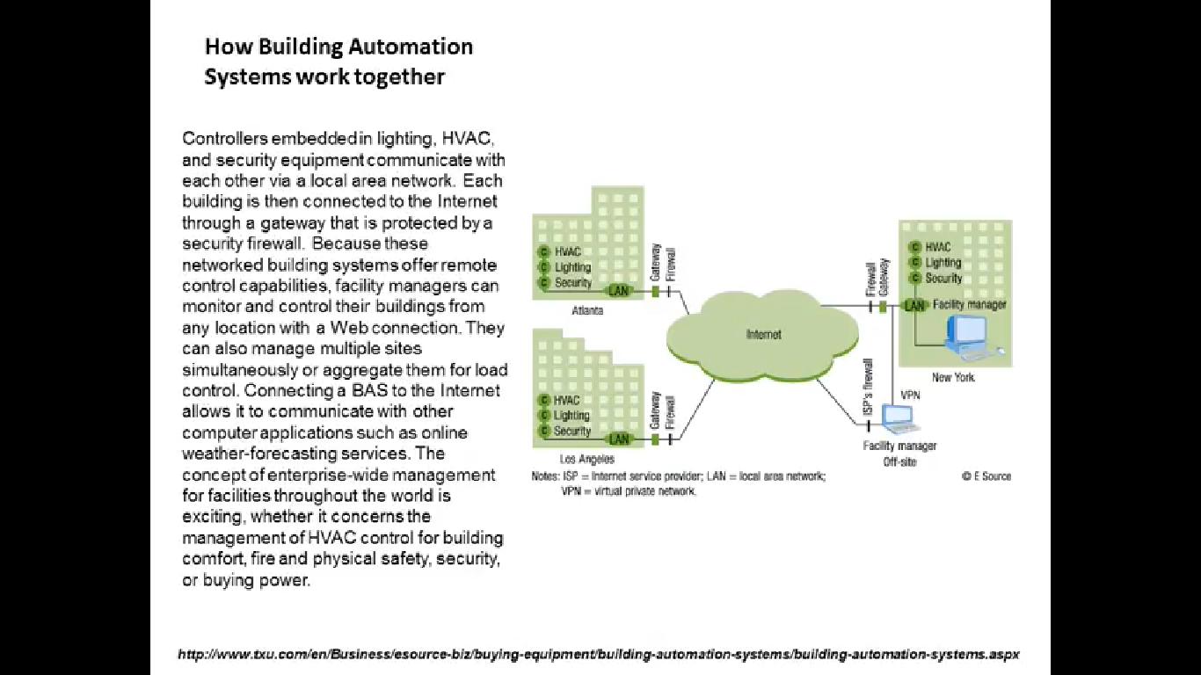
BMS

Slide 9
EMS
Energy management systems are also often commonly used by individual commercial entities to monitor, measure, and control their electrical building loads.
Energy management systems can be used to centrally control devices like HVAC units and lighting systems across multiple locations, such as retail, grocery and restaurant sites.
Energy management systems can also provide metering, sub metering, and monitoring functions that allow facility and building managers to gather data and insight that allows them to make more informed decisions about energy activities across their sites.

Slide 10
EMS vs BMS
Energy Management Systems vs. Building Automation System
Energy management systems and building automation systems serve two very different functions.
Example - Perhaps the easiest way to understand the difference is to think of your building as a car. An energy management system is the dashboard of your car: it allows you to see all the controls and understand how all components are operating. With this high-level view, you accurately direct your car.

Slide 11
EMS vs BMS
That’s when the building automation system comes in. BAS acts as the steering wheel: you can direct the car by telling it what to do. You can set it on “cruise” mode to drive on autopilot, but you’ll still need to run frequent, necessary checks to make sure everything is working properly.

Slide 12
EMS vs BMS
Your building operates the same way. A good energy management software provides an overview of your portfolio operations, with the option to explore a potential problem before it happens.
You then use this information to set your building automation system to run most efficiently.

Slide 13
EMS vs BMS
Where Do I Start?
If you don’t have either a BMS or an EMS in your building, you should start by installing web-enabled meters and monitoring meter data with an energy management system. Here’s why:
First, meters can be installed in any building and will get you started for a fraction of the cost of a building management system. Maybe you even already have meters that integrate with your EMS.

Slide 14
Second, you can get actionable data in under 30 days and get a return on your investment right away. After setting up meters and real-time energy management software, Cassidy Turley (now DTZ) identified $91,000 in annual energy cost savings in one of their buildings, thus justifying future investments in energy efficiency efforts.
Third, you can identify opportunities and justify capital investments (such as investing in a BMS).

Slide 15
Quick Review Question
Define BMS. What are the components of BMS?
Compare BMS with EMS.
How Building Management Systems work?

Slide 16
Summary of Main Teaching Points
Discussed and compared BMS with EMS in detail.

Slide 17
Question and Answer Session
Q & A

Slide 18
What we will cover next
Commissioning and Handover

